Slide 1





Project Sportan

Slide 2








THE ULTIMATE T20 GAME
VS
PLANET
EARTH
PLANET
SPARTA

Slide 3
APPROACH
DATA GATHERING
DATA TRANSFORMATION
DATA STORING
DATA CLEANING
DAX MEASURES
DASH BOARD DESING

Slide 4


DATA GATHERING
DATA TRANSFORMATION

Slide 5

DATA STORING

Slide 6
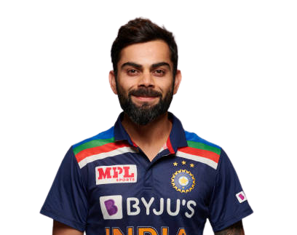
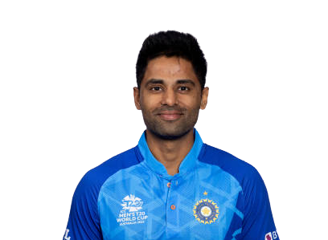
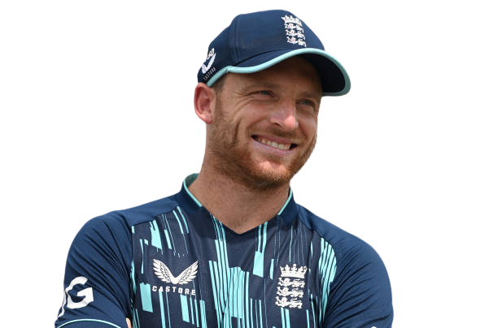
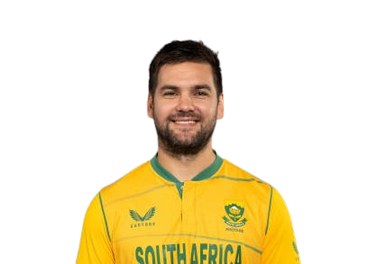
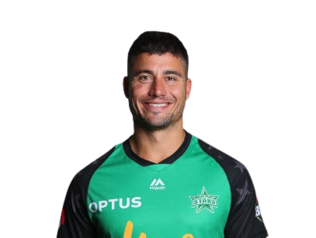
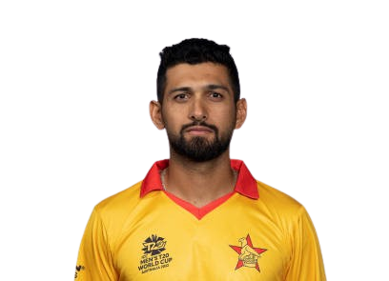
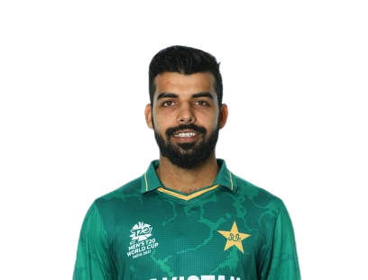
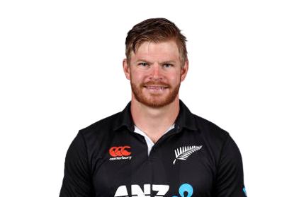
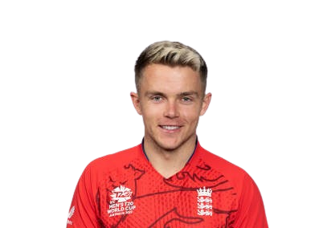
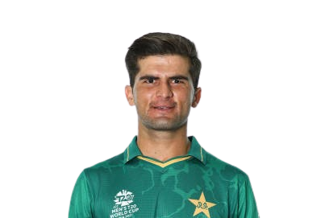
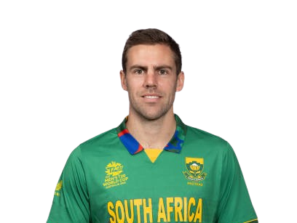
PLAYING 11
JOS BUTTLER
RILEE ROSSOUW
VIRAT KOHLI
SURYAKUMAR YADAV
GLENN PHILLIPS
Marcus Stoinis
Sikandar Raza
Shadab Khan
Sam Curran
Shaheen Shah Afridi
Anrich Nortje

